Slide 1


Slide 2
Page Replacement Algorithms
Presented By:
Huzaifa Shahbaz(21-CE-009)
Muhammad Ibthesam (21-ce-020)
Yawar Ali Malik (21-CE-021)

Slide 3
OUTLINES
Abstract
Introduction
Problem Statement
Objective
Expected Outcome
Components Used
Project Diagram
First In, First Out
First In, First Out diagram
CODE OF First In, First Out diagram
Least recently used

Slide 4
OUTLINES(continued)
Least Recently used diagram
CODE OF Least Recently used
Least Frequently Used
Least Frequently Used diagram
CODE OF Least Frequently Used
Optimal Page Replacement
Optimal Page Replacement Diagram
CODE OF Optimal Page Replacement
CODE OF Page Replacement Algorithms
Results of Page Replacement Algorithms
Conclusion

Slide 5
Abstract
Page replacement algorithms are critical for managing a computer's memory by deciding which pages to swap out when new pages need to be loaded.
Common algorithms include FIFO (First-In-First-Out), LRU (Least Recently Used), and Optimal Page Replacement, each with distinct strategies for determining which page to replace.
These algorithms balance efficiency and complexity to maintain effective memory utilization.
Research in this area continues to evolve, enhancing system performance and resource management.

Slide 6
Introduction
Paging is a type of memory management scheme which the computer uses to store and receive data from the secondary storage and uses that in the main memory.
This scheme allows the physical address space of a process to be non-contiguous.
Example
There is a process of size: 4
Bytes The size of a single page: 2
Bytes Number of pages/Process: 4/2 = 2
To follow the concept of paging the MMU makes a page table.
Every process has its own page table.
The number of pages in a page table is the same as the number of pages in a process.

Slide 7
Introduction(continued)
Example
The process 1 above, will have two entries in its page table.
The page table however contains the “Frame No” which is the address in main memory where the data required is stored.

Slide 8
Problem Statement
Developing a paging memory management system is essential for efficient data handling in computers.
This project aims to design an optimized paging mechanism where the Memory Management Unit (MMU) maintains page tables for each process, correlating virtual addresses to physical memory locations.
Challenges include optimizing page table size, minimizing access latency, and ensuring smooth data transfer between secondary and primary storage, providing an efficient solution for modern computing.

Slide 9
Objective
The objective of this project is to implement a paging memory management system to efficiently manage data in computer systems.
This involves designing an optimized paging mechanism where the Memory Management Unit (MMU) maintains page tables for each process.
The goal is to address challenges such as optimizing page table size, minimizing access latency, and ensuring seamless data transfer between secondary and primary storage, ultimately enhancing overall system performance and resource utilization.

Slide 10
Expected Outcome
The expected outcome of implementing an effective page replacement algorithm is a reduction in the number of page faults, leading to improved system performance and faster execution times.
Enhanced memory utilization ensures that the most frequently accessed data is readily available, minimizing delays.
This contributes to an overall smoother and more efficient operation of applications.
Additionally, a well-chosen algorithm can extend the lifespan of hardware by reducing unnecessary wear from excessive data swapping.

Slide 11
Components Used
The Components used of page replacement algorithm following are
Ubnutu
Sublime Text editor
GCC Compiler
Terminal

Slide 12
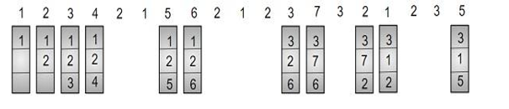
Project Diagram
Page Replacement
Algorithm Diagram

Slide 13
First In-First Out
This algorithm replaces the oldest page in memory when a page fault occurs.
It keeps track of all pages in memory in a queue and when a page fault occurs, the page at the front of the queue is removed and a new page is added to the back of the queue.

Slide 14
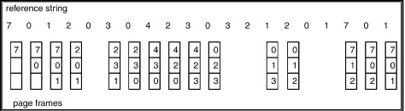
First In-First Out

Slide 15
Code OF First In-First Out
void fifo(int pages[], int n, int capacity)
{
int frame[capacity], front = 0, page_faults = 0;
for (int i = 0; i < capacity; i++)
frame[i] = -1;
for (int i = 0; i < n; i++)
{
int found = 0;
for (int j = 0; j < capacity; j++)
{

Slide 16
Code OF First In-First Out(CONTINUED)
if (frame[j] == pages[i])
{
found = 1;
break;
}
}
if (!found)
{
frame[front] = pages[i];

Slide 17
Code OF First In-First Out(CONTINUED)
front = (front + 1) % capacity;
page_faults++;
}
}
printf("FIFO Page Faults: %d\n", page_faults);
}

Slide 18
Least Recently Used
The LRU page replacement algorithm replaces the least recently used page in the memory with a new page.
The LRU page replacement algorithm is based on the assumption that among all pages in the memory, the least recently used page will not be used for a long time.

Slide 19
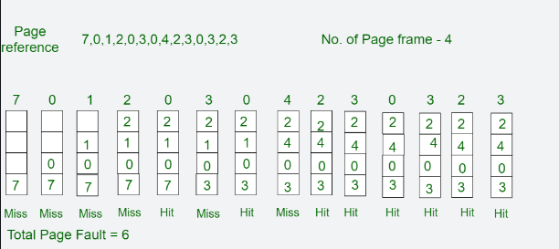
Least Recently Used Diagram

Slide 20
Code of Least Recently Used
void lru(int pages[], int n, int capacity)
{
int frame[capacity], time[capacity], page_faults = 0, counter = 0;
for (int i = 0; i < capacity; i++)
frame[i] = -1;
for (int i = 0; i < n; i++)
{
int found = 0, lru_index = 0;
for (int j = 0; j < capacity; j++)

Slide 21
Code of Least Recently Used(Continued)
{
if (frame[j] == pages[i])
{
found = 1;
time[j] = ++counter;
break;
}
}
if (!found)
{

Slide 22
Code of Least Recently Used(Continued)
int min_time = counter + 1;
for (int j = 0; j < capacity; j++)
{
if (time[j] < min_time)
{
min_time = time[j];
lru_index = j;
}
}

Slide 23
Code of Least Recently Used(Continued)
frame[lru_index] = pages[i];
time[lru_index] = ++counter;
page_faults++;
}
}
printf("LRU Page Faults: %d\n", page_faults);
}

Slide 24
Least Frequently Used
It removes the page that has not been utilized in the memory for the longest period of time.
It replaces the least frequently used pages. It keeps track of page usage in the memory over a short time period.

Slide 25
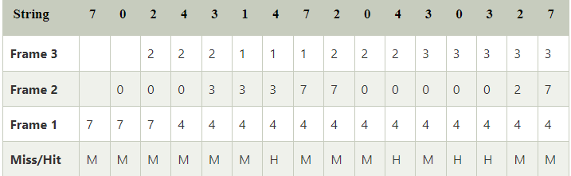
Least Frequently Used Diagram

Slide 26
CODE OF Least Frequently Used
void lfu(int pages[], int n, int capacity)
{
int frame[capacity], count[capacity], page_faults = 0;
for (int i = 0; i < capacity; i++)
{
frame[i] = -1;
count[i] = 0;
}
for (int i = 0; i < n; i++)
{

Slide 27
CODE OF Least Frequently Used (Continued)
int found = 0, lfu_index = 0;
for (int j = 0; j < capacity; j++)
{
if (frame[j] == pages[i])
{
found = 1;
count[j]++;
break;
}
}

Slide 28
CODE OF Least Frequently Used (Continued)
if (!found)
{
int min_count = n + 1;
for (int j = 0; j < capacity; j++)
{
if (frame[j] == -1)
{
lfu_index = j;
break;
}
else if (count[j] < min_count)
{
min_count = count[j];

Slide 29
CODE OF Least Frequently Used (Continued)
lfu_index = j;
}
}
frame[lfu_index] = pages[i];
count[lfu_index] = 1;
page_faults++;
}
}
printf("LFU Page Faults: %d\n", page_faults);
}

Slide 30
Optimal Page Replacement
The optimal page replacement (OPT) algorithm is a memory management technique.
It minimizes the number of page faults by predicting future accesses and replacing the least recently used pages.

Slide 31
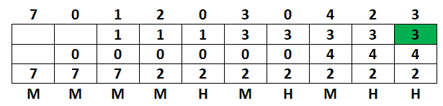
Optimal Page Replacement Diagram

Slide 32
CODE OF Optimal Page Replacement
void optimal(int pages[], int n, int capacity)
{
int frame[capacity], page_faults = 0;
for (int i = 0; i < capacity; i++)
frame[i] = -1;
for (int i = 0; i < n; i++)
{
int found = 0, replace_index = 0;
for (int j = 0; j < capacity; j++)
{

Slide 33
CODE OF Optimal Page Replacement (Continued)
if (frame[j] == pages[i])
{
found = 1;
break;
}
}
if (!found)
{
int farthest = i + 1;

Slide 34
CODE OF Optimal Page Replacement (Continued)
for (int j = 0; j < capacity; j++)
{
int k;
for (k = i + 1; k < n; k++)
{
if (frame[j] == pages[k])
break;
}
if (k == n)
{
replace_index = j;
break;

Slide 35
CODE OF Optimal Page Replacement (Continued)
for (int j = 0; j < capacity; j++)
{
int k;
for (k = i + 1; k < n; k++)
{
if (frame[j] == pages[k])
break;
}
if (k == n)
{
replace_index = j;
break;

Slide 36
CODE OF Optimal Page Replacement (Continued)
}
else if (k > farthest)
{
farthest = k;
replace_index = j;
}
}
frame[replace_index] = pages[i];
page_faults++;
}
}
printf("Optimal Page Faults: %d\n", page_faults);
}

Slide 37
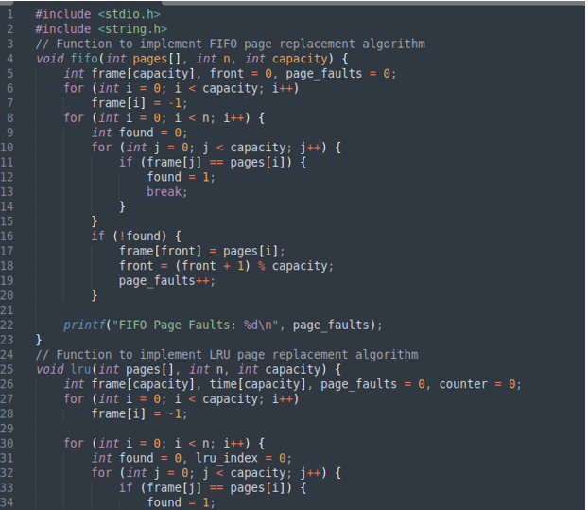
Code of Page Replacement Algorithm

Slide 38
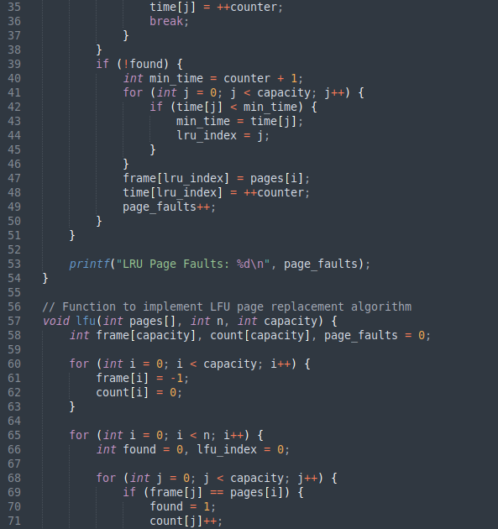
Code of Page Replacement Algorithm(Continued)

Slide 39
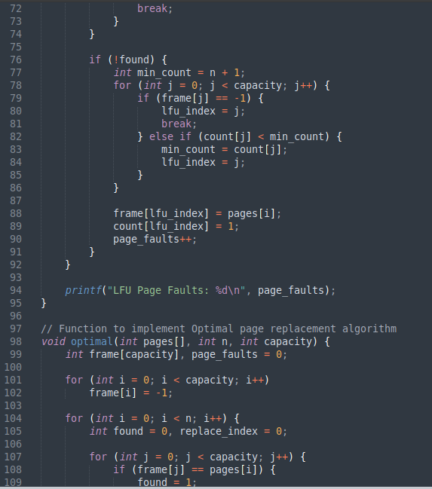
Code of Page Replacement Algorithm(Continued)

Slide 40
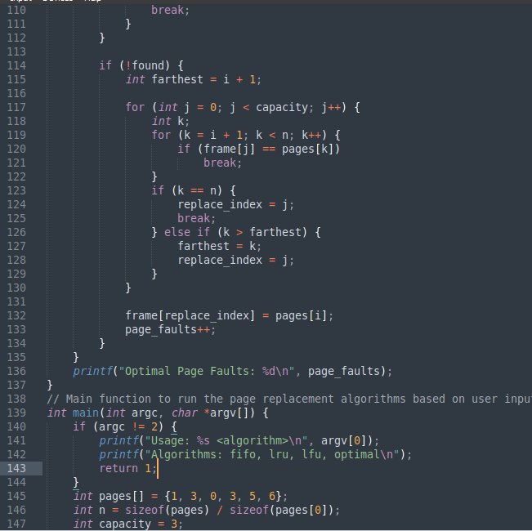
Code of Page Replacement Algorithm(Continued)

Slide 41
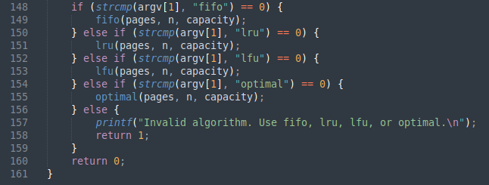
Code of Page Replacement Algorithm(Continued)

Slide 42
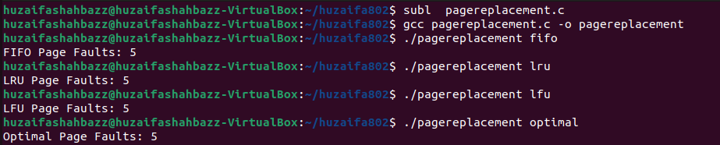
Results Of page replacement algorithm

Slide 43
Conclusion
In conclusion, the developed paging memory management system optimizes data handling in computer systems.
By maintaining page tables for each process, minimizing access latency, and ensuring efficient data transfer, overall system performance is enhanced.
Further refinement will continue to advance modern computing technologies.

